Slide 1
Iterator Design Pattern
Opriş Bogdan-Alexandru
30432_2

Slide 2
Introduction Very commonly used; Access elements of a collection in sequential manner; No need to know its underlying representation; Falls under the behavioral pattern category.

Slide 3
What problems does it solve? The elements of an aggregate object should be accesed and traversed without exposing its representation (data structures); New traversal operations should be defined for an aggregate object without changing its interface; Hiding the implementation which is a core principle of Object Oriented Programming (abstraction).

Slide 4
Advantages Traverse collections; Provides many features such as next(), hasNext(), update, remove, etc.
Disadvantages
Harder to update the structure being iterated;
Backtracking while processing through a list may not work at all.

Slide 5
Solution Define a separate (iterator) object that encapsulates accessing and traversing an aggregate object; Clients use it to access and traverse an aggregate without knowing its representation.

Slide 6
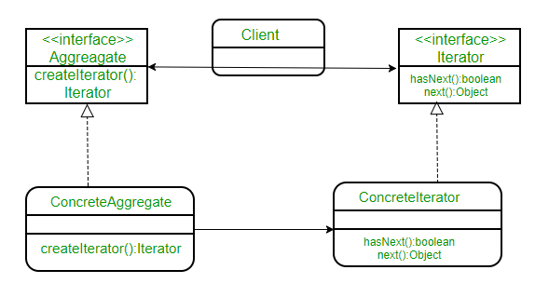
Class Diagram ConcreteAggregate implements createIterator() that returns iterator for its collection. The Iterator interface provides a set of methods for traversing or modifying the collection. Can also provide search, remove, and other functions.

Slide 7
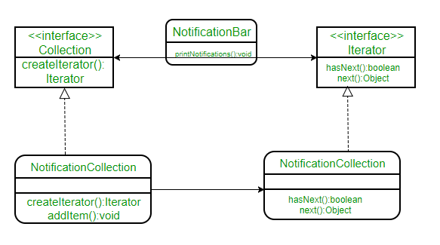
Example Creating a notification bar that displays all the notifications which are held in a notification collection. NotificationCollection provides an iterator to iterate over its elements without exposing how it has implemented the Collection to the Client.

Slide 8
